Slide 1
Project: Financial Calculator
Subtitle: Loan Payment Calculation
Compound Interest Calculation
Savings Growth Calculation :
Group Members E
Alie Ibrahim Thoronka
Foday Marrah
Mohamed Amara Kamara
Mohamed S Kante
Thomas Steven

Slide 2
Loan Calculator
Purpose: To determine monthly payments, total interest paid, and generate an amortization schedule for loans.

Slide 3
Features
Principal Amount: Input the total amount of the loan you wish to borrow
Interest Rate: Enter the annual interest rate (APR) associated with the loan.
Loan Term: Specify the duration of the loan in years or months. The calculator can handle various terms, making it adaptable to different loan types.
Monthly Payment Calculation: The calculator computes the estimated monthly payment, allowing users to understand their financial commitments.
Total Payment and Interest: View the total amount paid over the life of the loan, including the total interest paid, helping users assess the cost of borrowing.

Slide 4
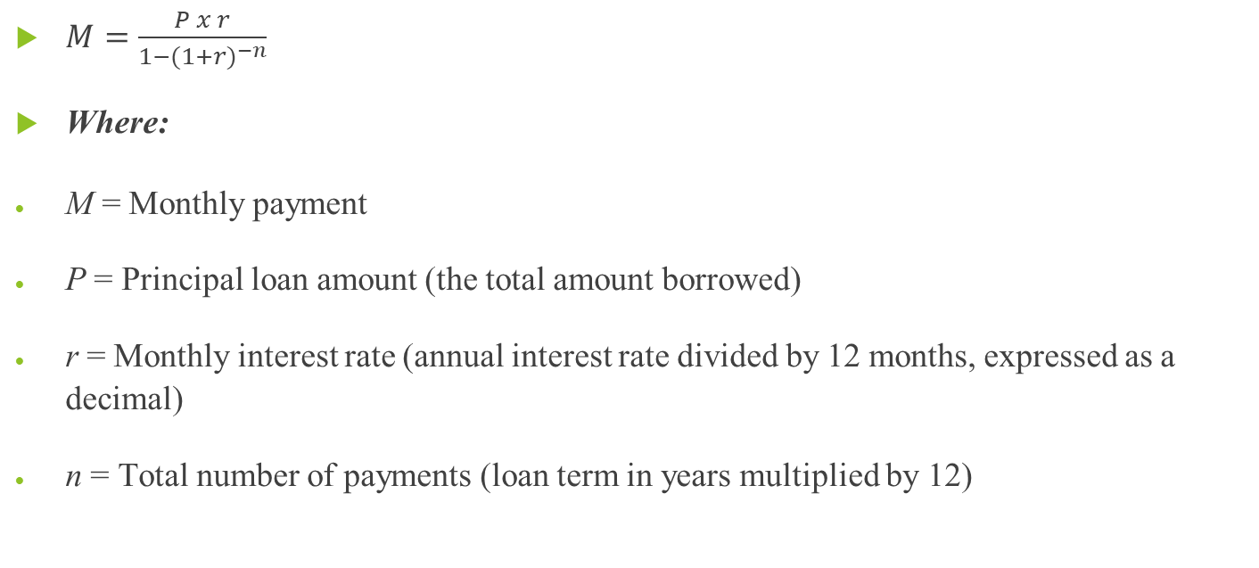
FORMULA FOR LOAN CALCULATION
$M=\frac{P x r}{1−(1+r)^{−n}}$
Where:
M = Monthly payment
P = Principal loan amount (the total amount borrowed)
r = Monthly interest rate (annual interest rate divided by 12 months, expressed as a decimal)
n = Total number of payments (loan term in years multiplied by 12)

Slide 5
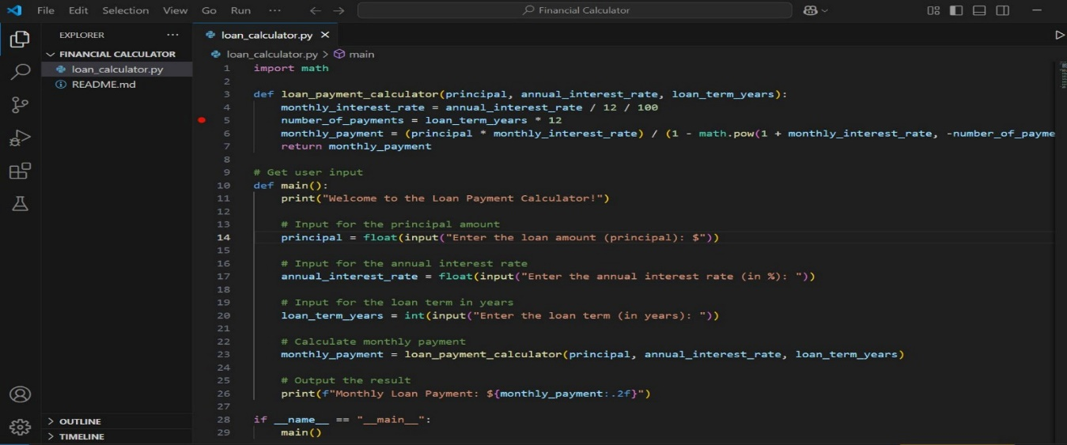
coding

Slide 6
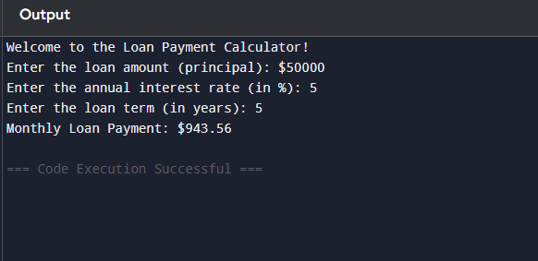

Slide 7
Challenges in the Process
Developing the Loan calculation requires understanding mathematical calculations and coding logic.
Run and Debugging Issue wherein the IDE can’t Run the code unless I use an online compiler (Programiz) to Run the code

Slide 8
Compound Interest Calculator
Purpose: To calculate the amount of interest earned on an investment over time, considering interest on both the initial principal and the accumulated interest.
Key Inputs:
Principal Amount: The initial amount of money invested or borrowed.
Annual Interest Rate: The percentage at which the investment grows.
Compounding Frequency: How often the interest is compounded (e.g., annually, semi-annually, quarterly, monthly).
Time Period: The duration for which the money is invested or borrowed.
.

Slide 9
Key Output
Key Outputs: Future Value (FV): The total amount of money accumulated after n years, including interest.
Total Interest Earned: The amount of interest earned over the investment period.

Slide 10
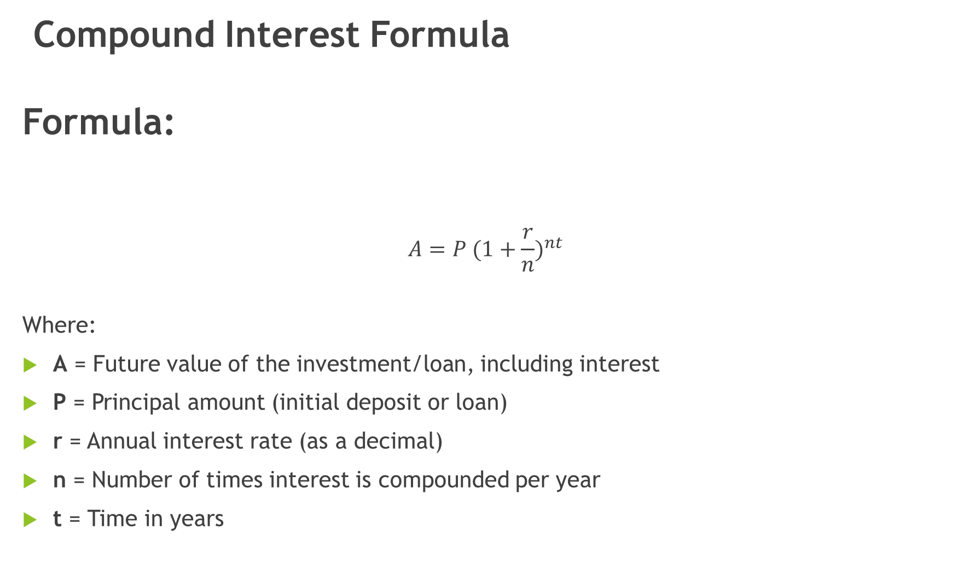
Compound Interest Formula Formula:
$$A=P (1+\frac{r}{n})^{nt}$$
Where:
A = Future value of the investment/loan, including interest
P = Principal amount (initial deposit or loan)
r = Annual interest rate (as a decimal)
n = Number of times interest is compounded per year
t = Time in years

Slide 11
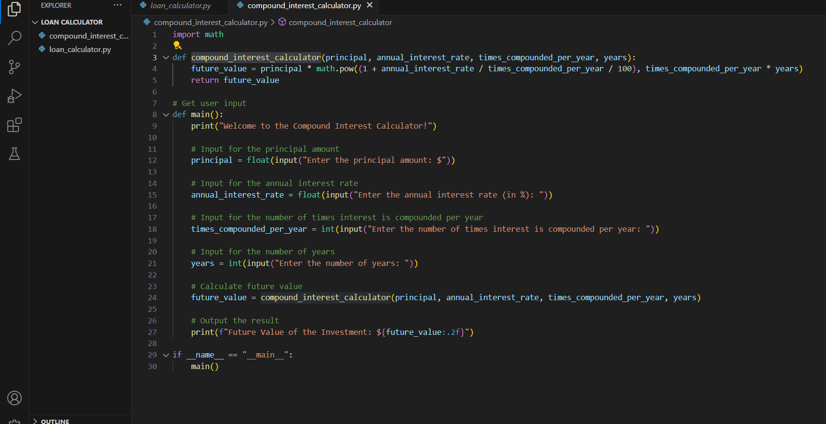
CODEING

Slide 12
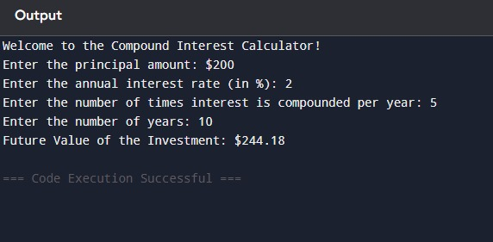

Slide 13
Challenges in the Process
Developing the compound interest calculator requires understanding mathematical calculations and coding logic.
Ensuring correct implementation and avoiding errors when pushing changes to GitHub.

Slide 14
Saving Growth
Purpose: To project how savings will grow over time based on regular contributions and an interest rate.
Key Inputs:
Initial Savings Amount: The starting amount in the savings account.
Monthly Contribution: Amount added to the savings each month.
Annual Interest Rate: The interest earned on the savings.
Time Period: The total duration for saving.

Slide 15
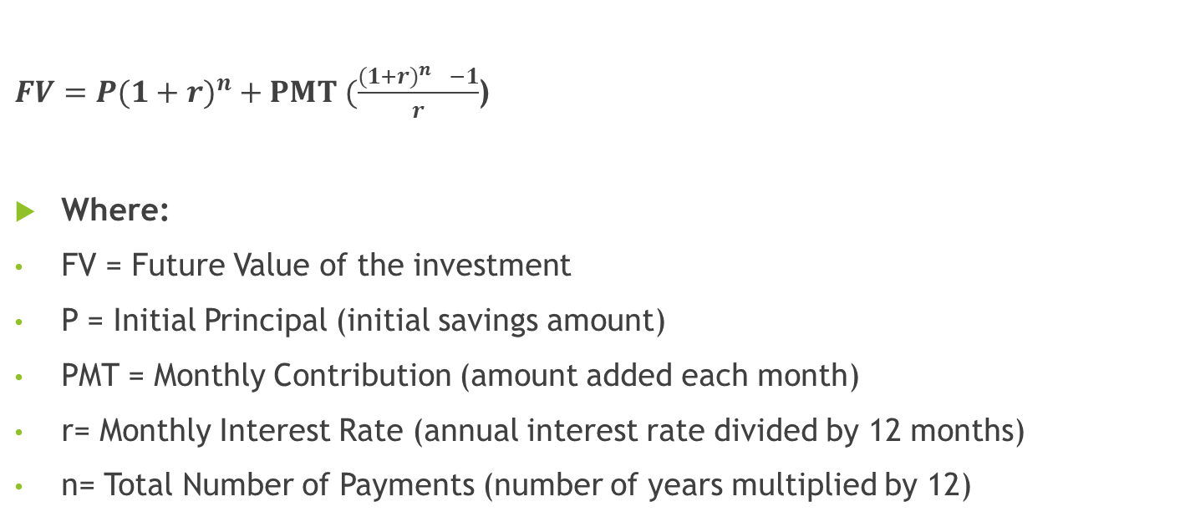
Formula For Saving Growth
$FV=P(1+r)^{n}+PMT (\frac{(1+r)^{n }−1}{r}$)
Where:
FV = Future Value of the investment
P = Initial Principal (initial savings amount)
PMT = Monthly Contribution (amount added each month)
r= Monthly Interest Rate (annual interest rate divided by 12 months)
n= Total Number of Payments (number of years multiplied by 12)

Slide 16
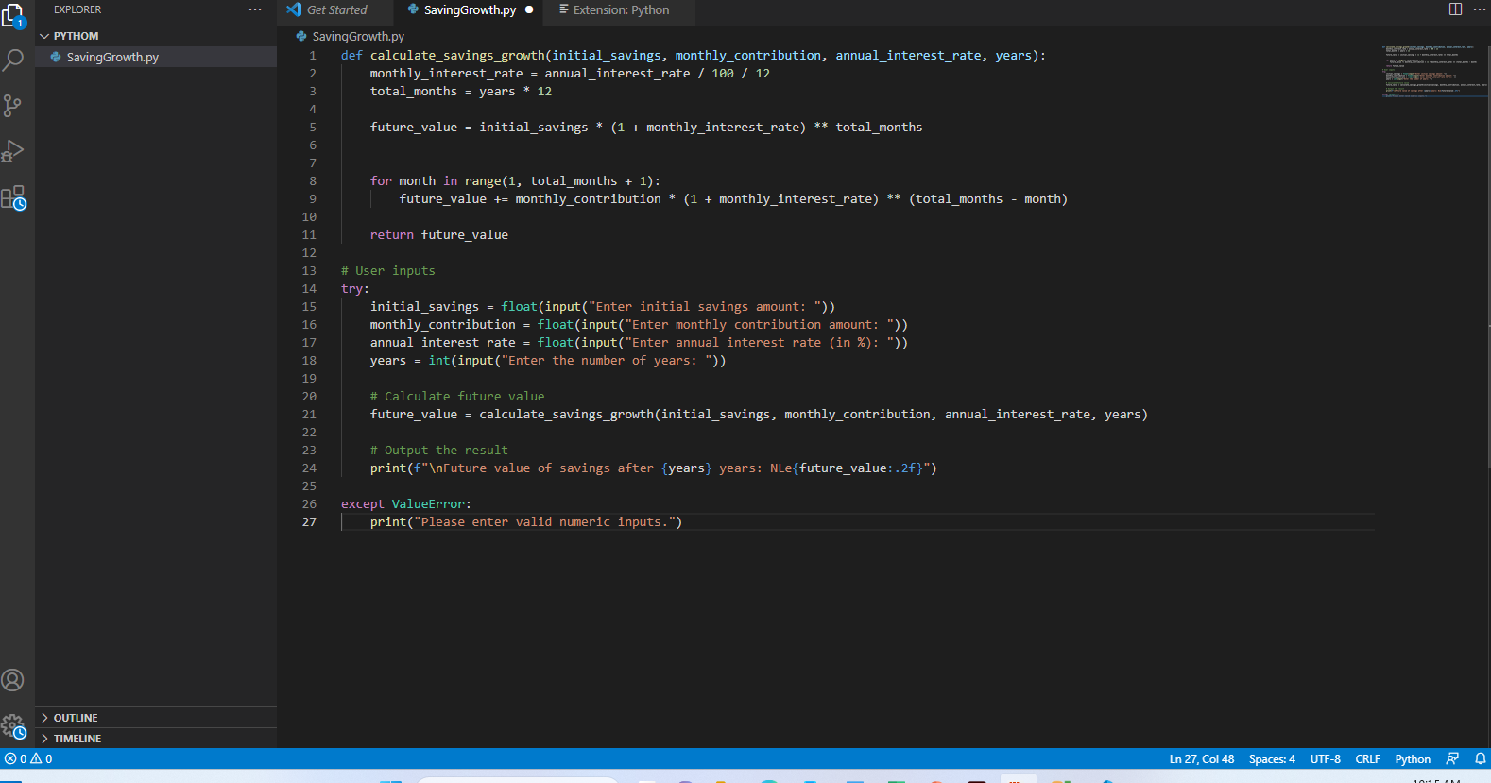
Code

Slide 17
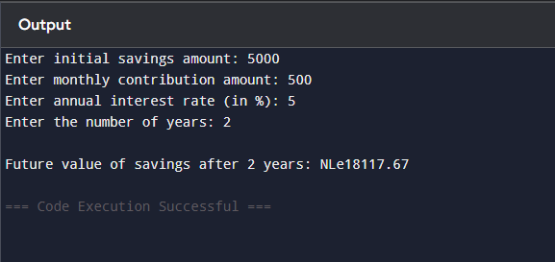
Output

Slide 18
GitHub
How was GitHub used?
Each team member had a separate branch (Loan, Interest, Savings, Documentation).
Alie merged all code into the main branch.
Git Commands Used
git clone https://github.com/LEO-lab-star/Financial-calculator-project.git git checkout -b branch-name git add . git commit -m "Added loan payment calculation" git push origin branch-name

Slide 19
Conclusion & Lessons Learned
Key Takeaways: Understanding financial calculations using Python
Learning GitHub for collaboration
Improving teamwork & problem-solving skills

